Slide 1
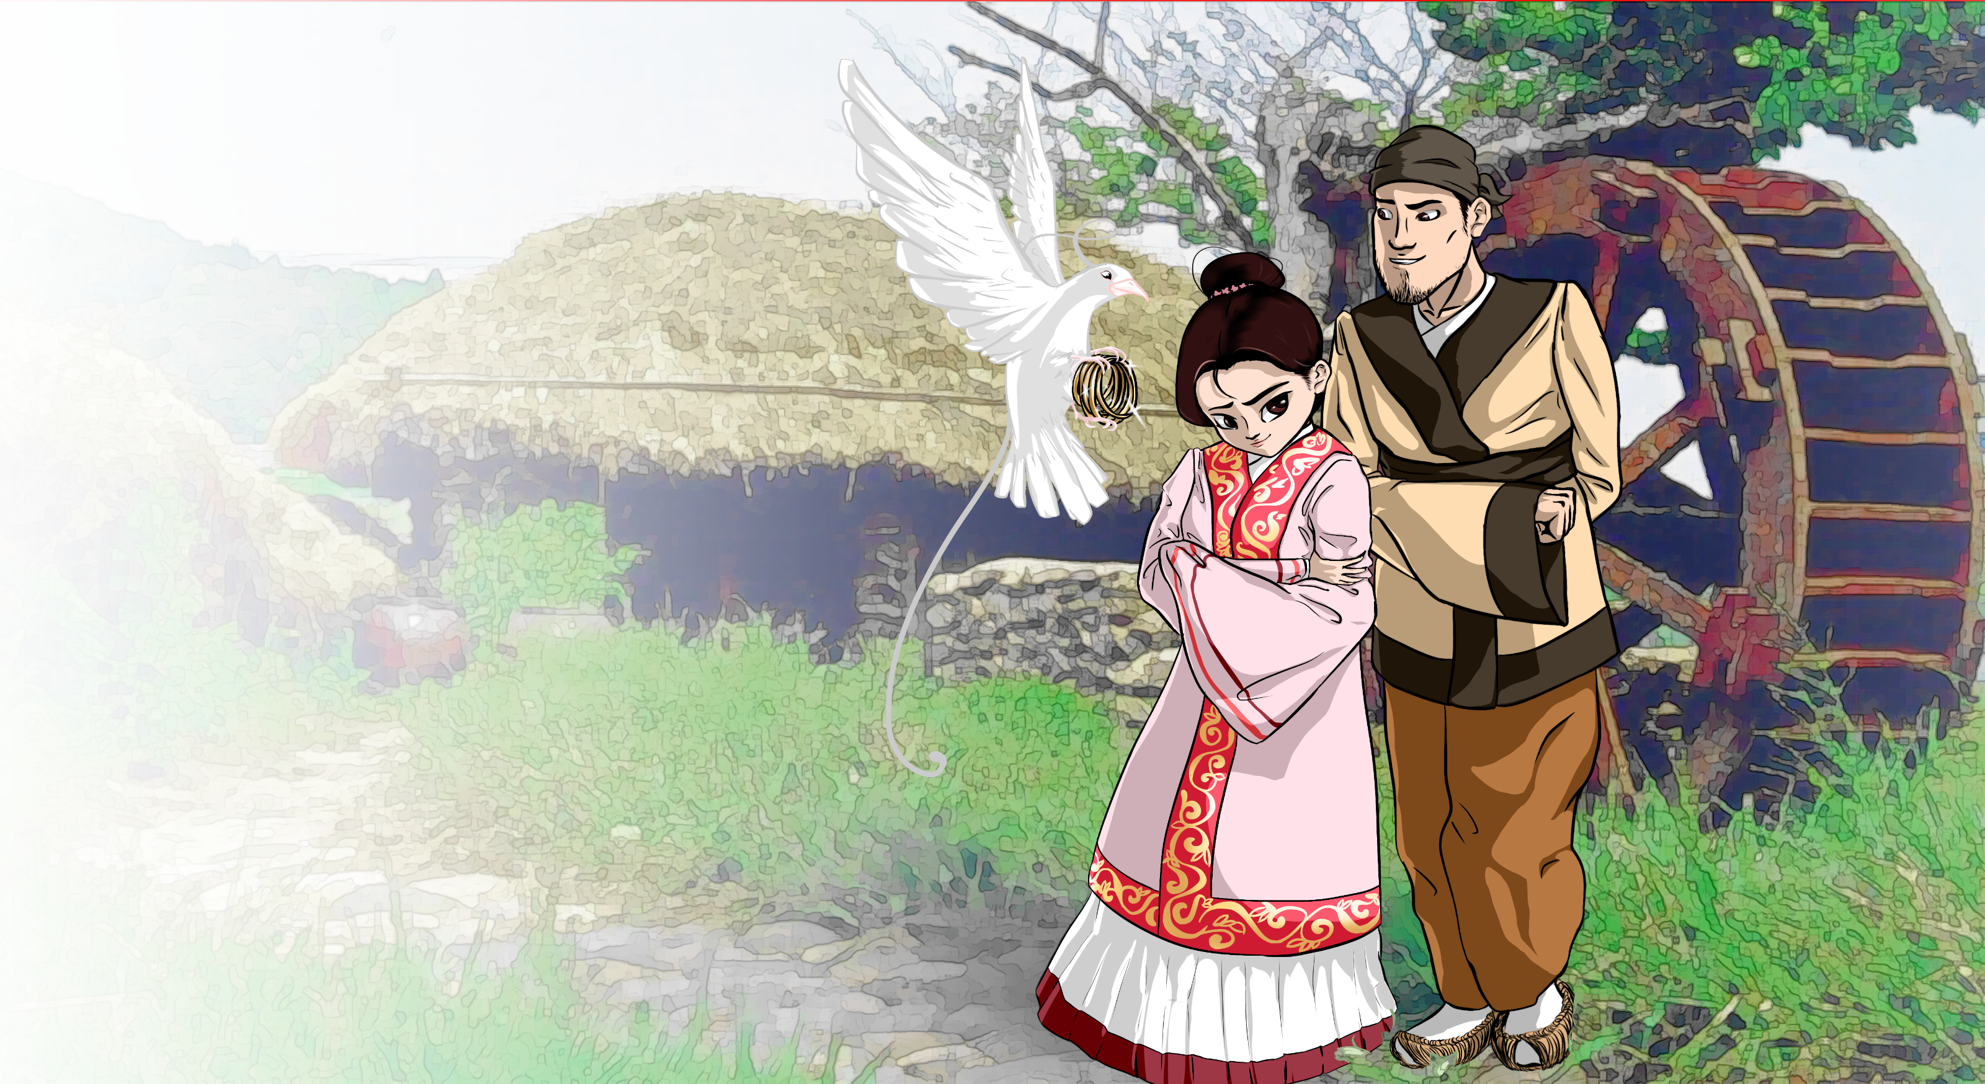
Characterization

Slide 2
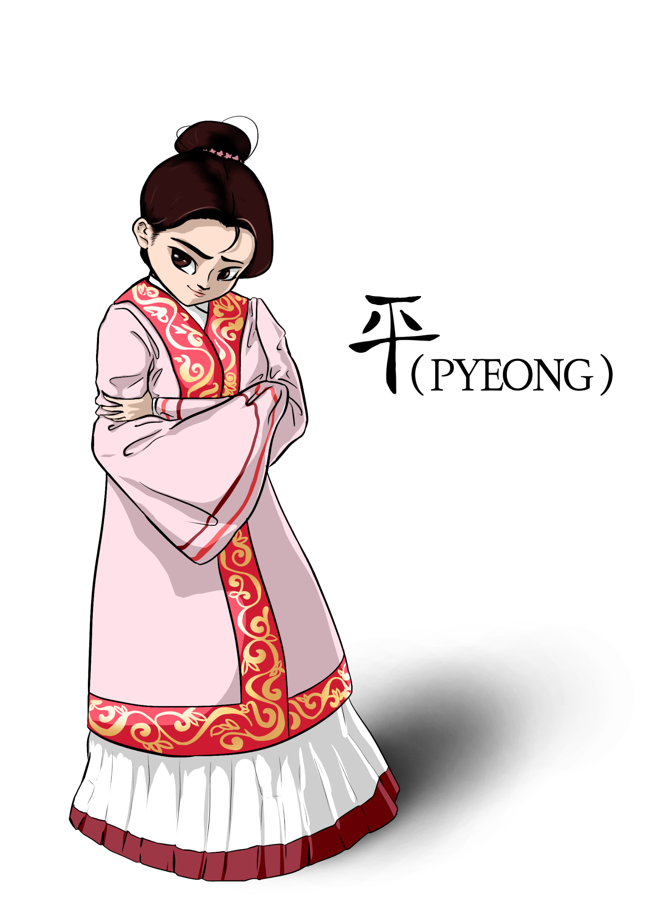
PYEONG
The Heroine Princess

Slide 3
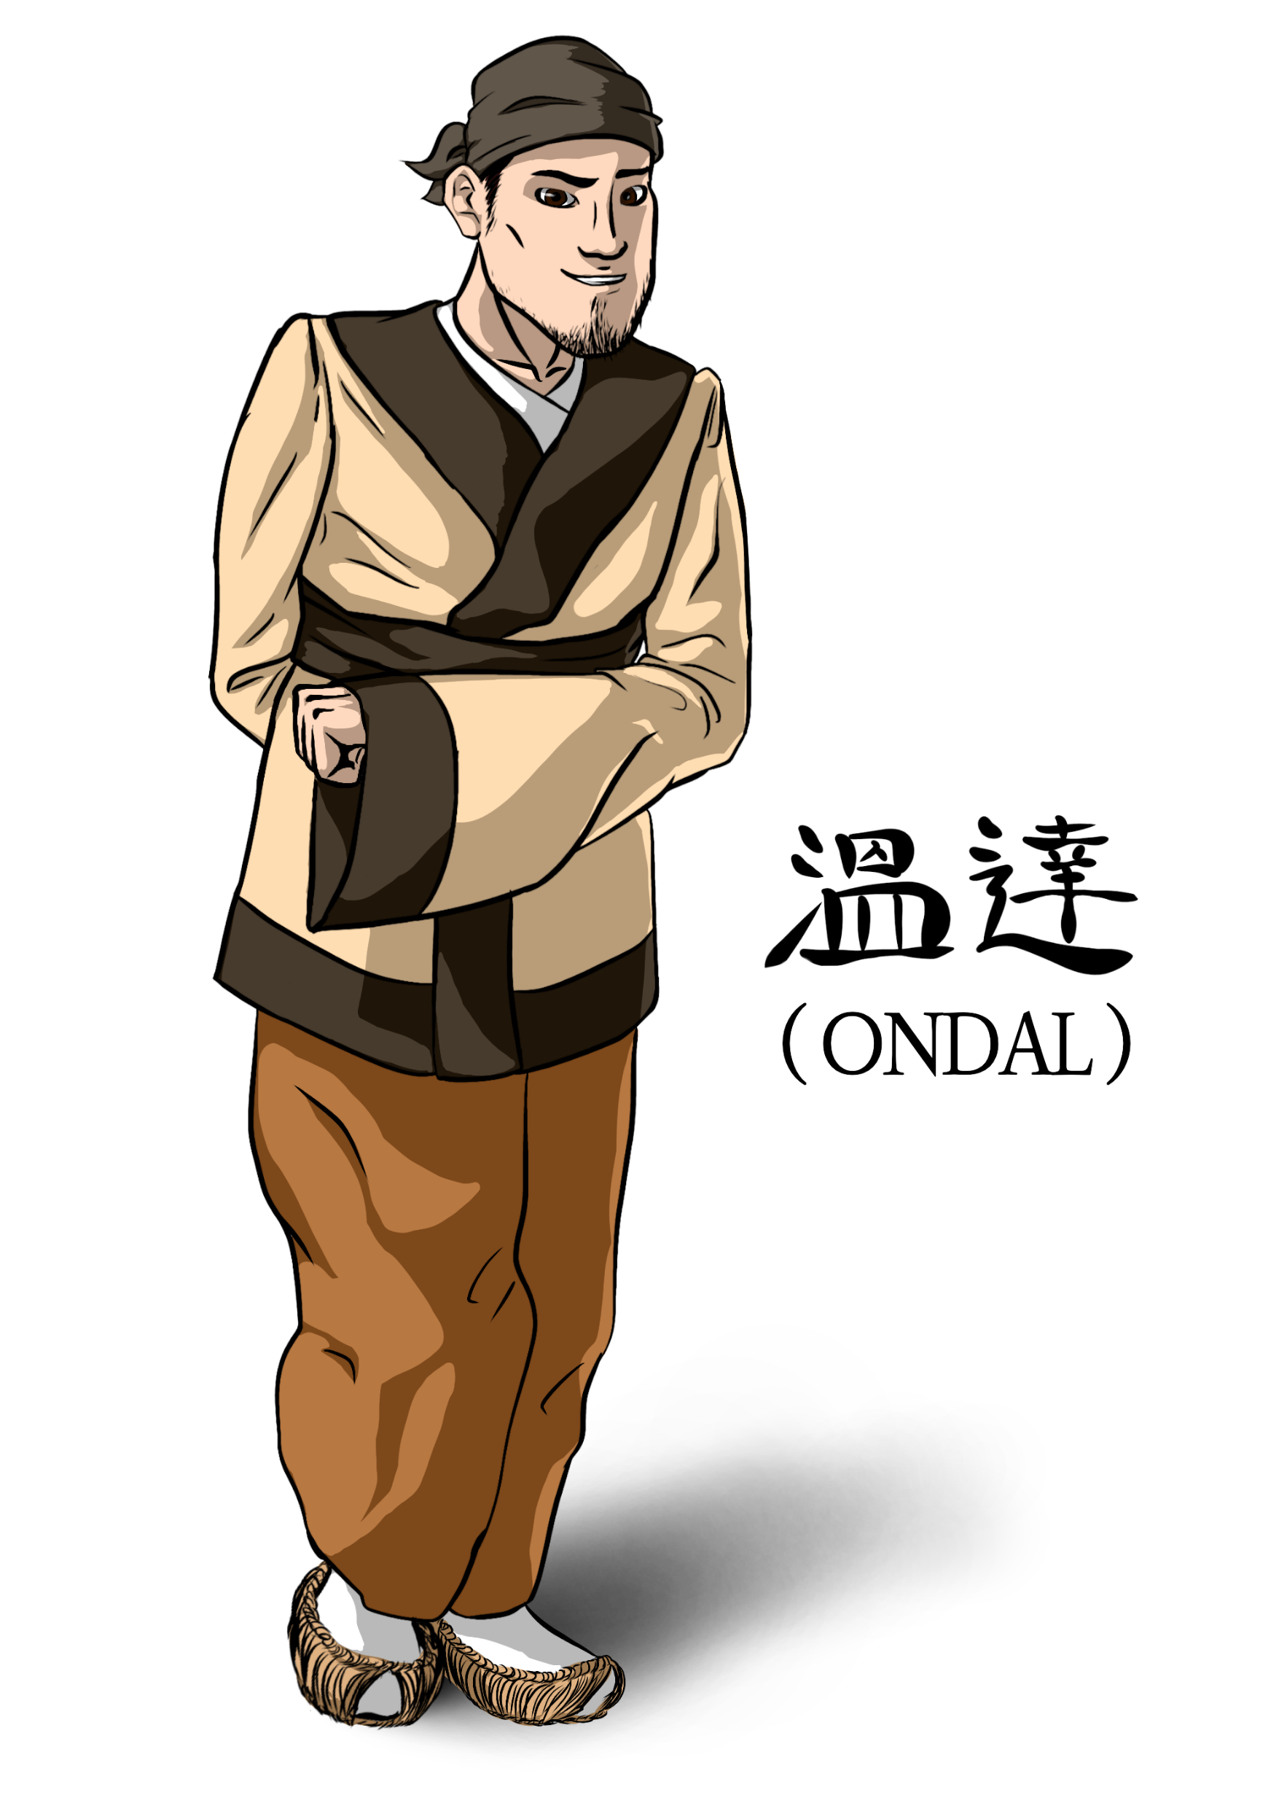
ONDAL
The Polished Hero

Slide 4
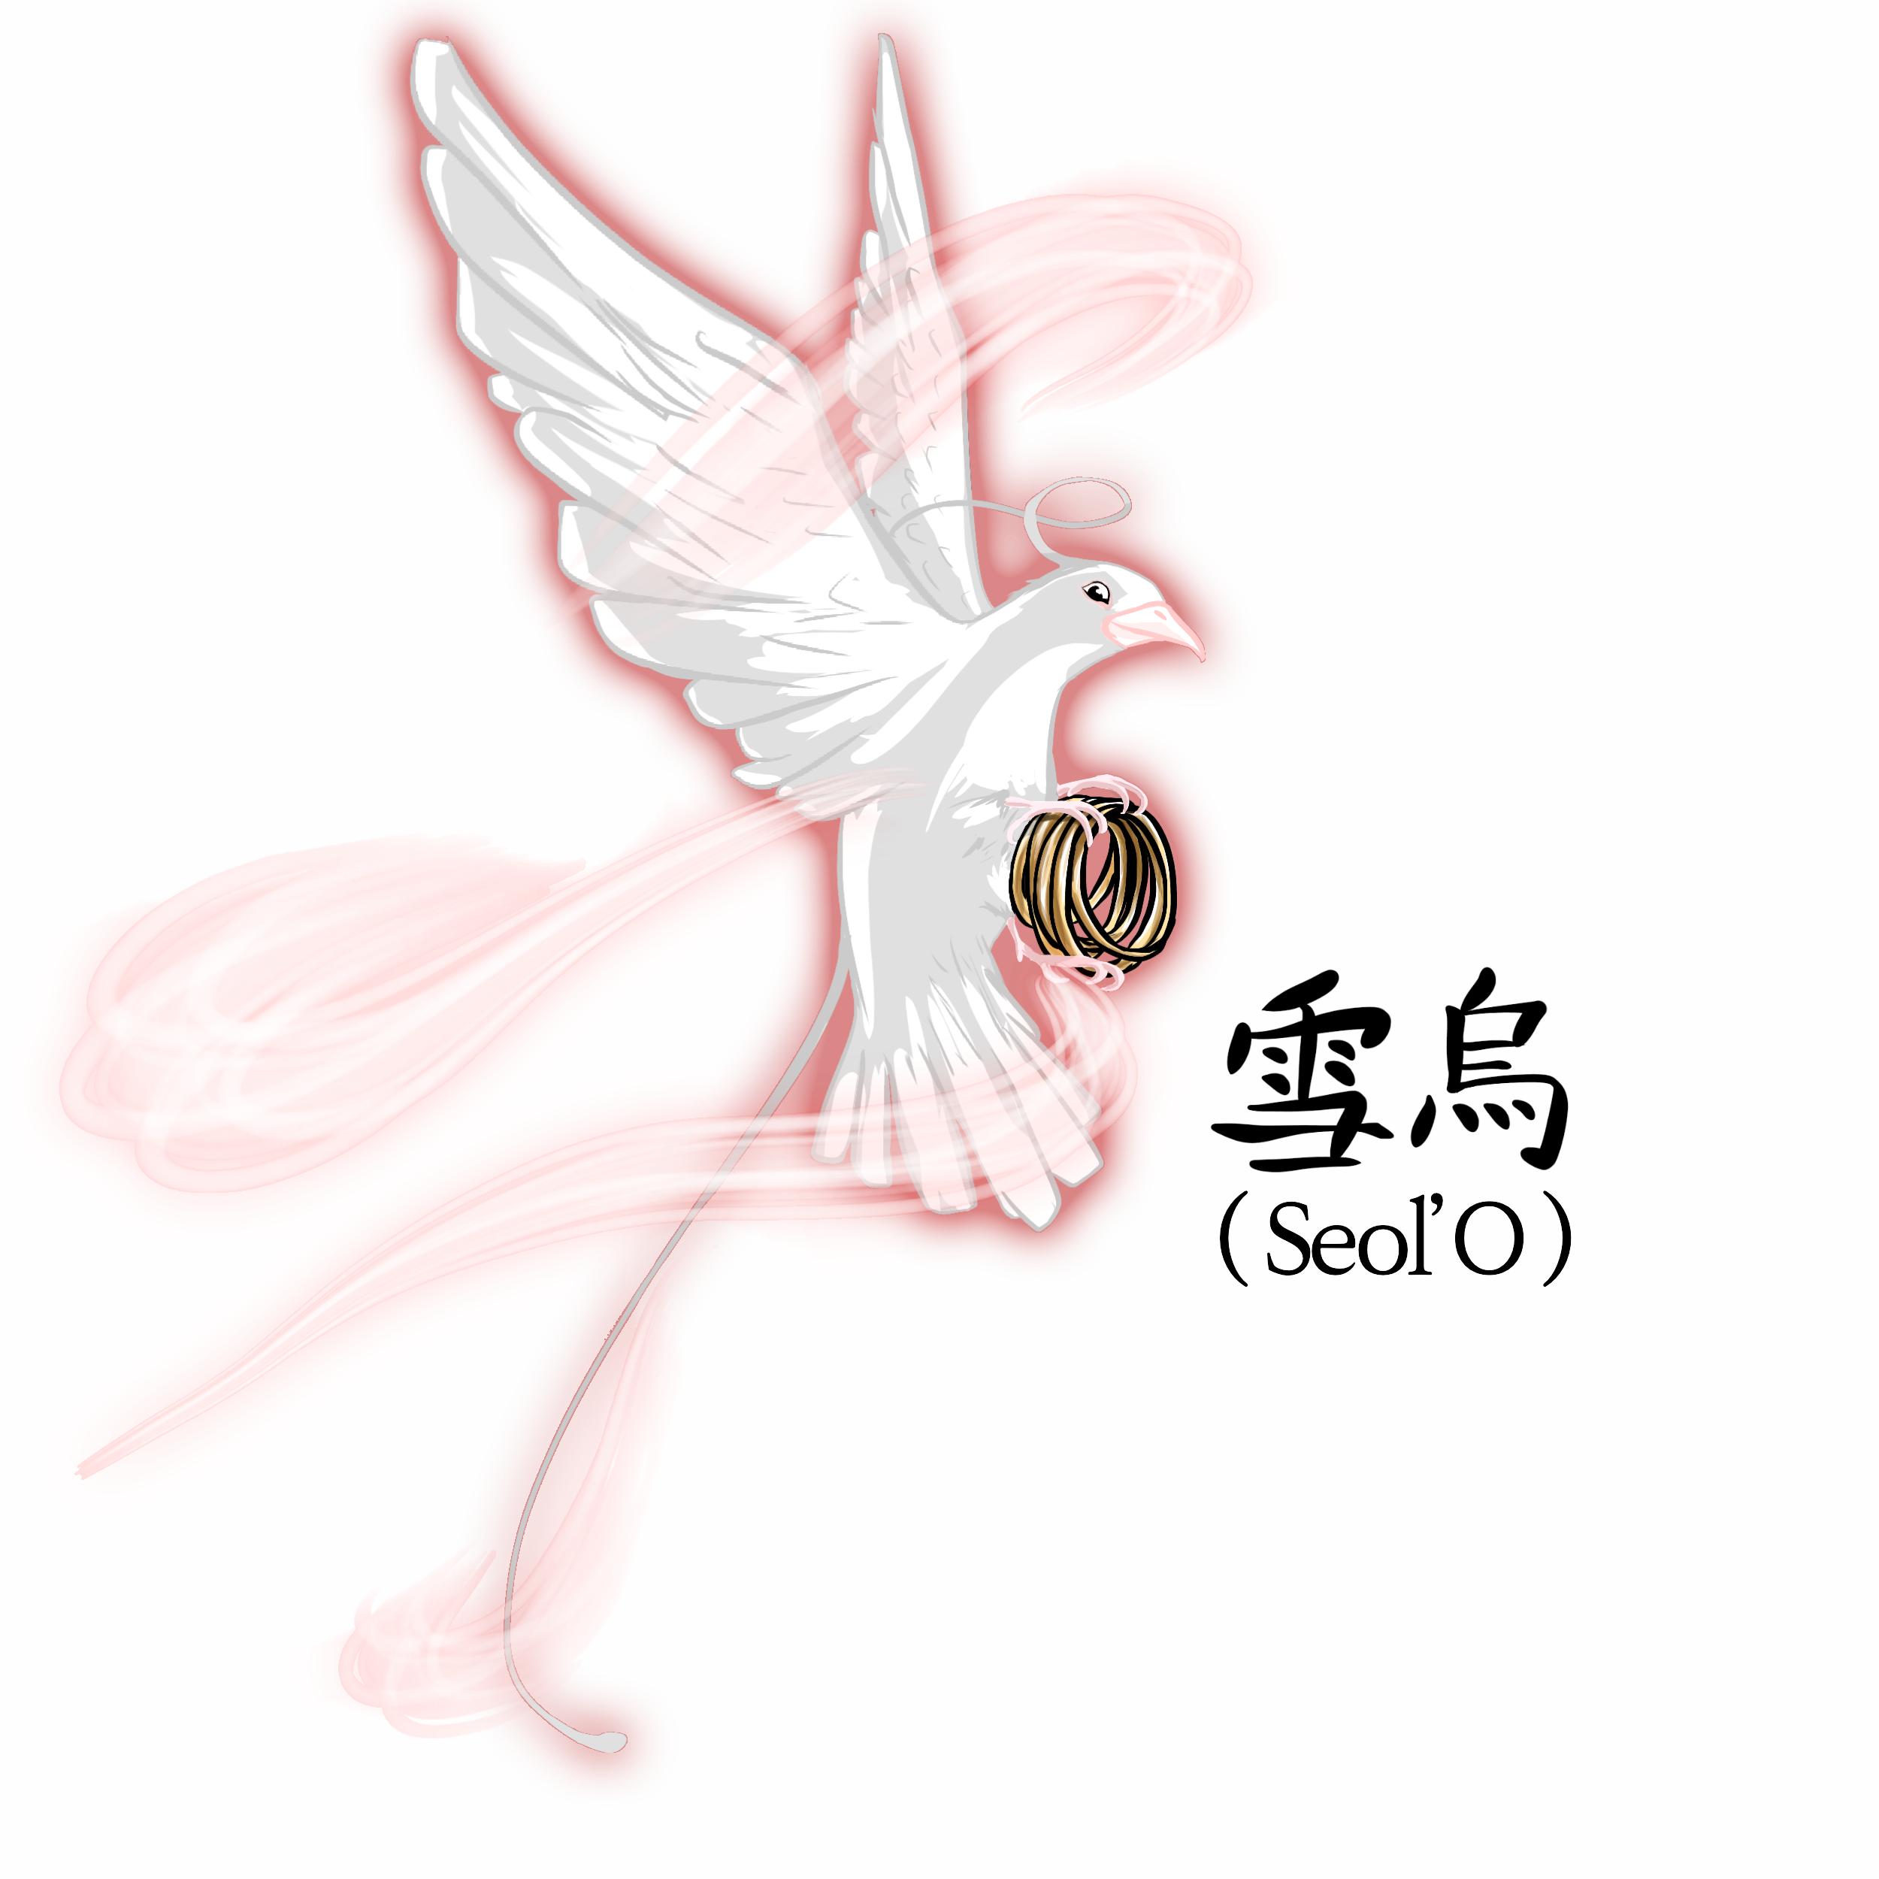
SEOL’O
The Sacred Helper
‘

Slide 5
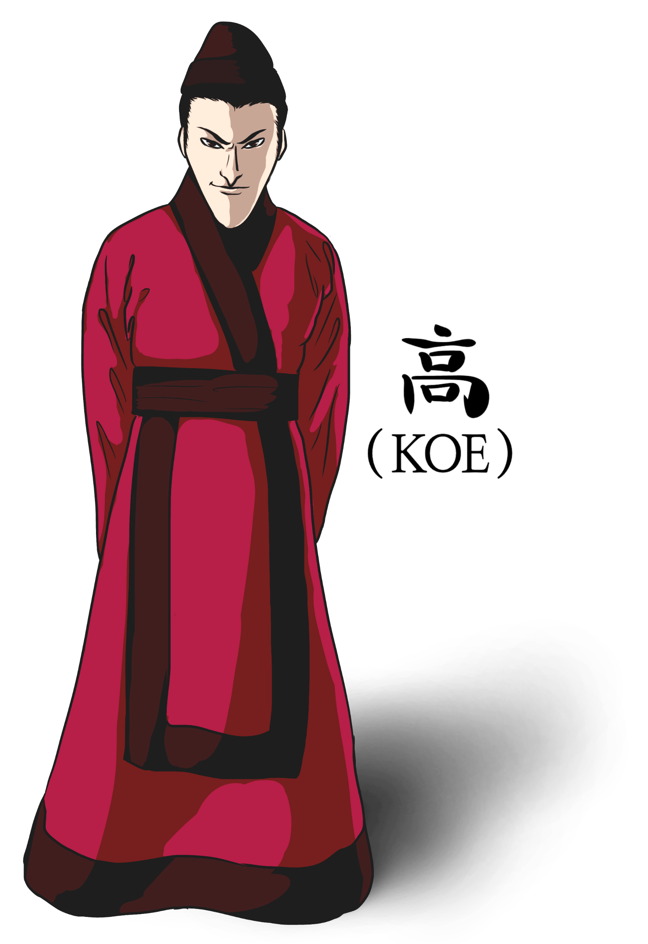
KOE
The Ambitious Villain

